Slide 1

(in)secure booting linux
Ángel Suárez-B. Martín

Slide 2


insecure booting linux
Ángel Suárez-B. Martín

Slide 3

whoami
Ángel Suárez-B. Martín – n0w
Security Engineer @ Logicalis
@asuarezbm
n0wblog.blogspot.com.es

Slide 4
Overview
Basic concepts
The boot process
BIOS
UEFI
Linux boot sequence
LUKS
initramfs
How full is full-disk encryption?
Attack vectors
Demo: Tampering with initrd
Possible Mitigations
Conclusions

Slide 5
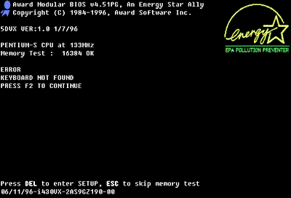

Boot sequence: The big picture
BIOS
Devices
RAM
MBR
Grub Stage 1
Grub Stage 2
Kernel
Initrd
Init
Userspace
POST
Boot
UEFI
Devices
RAM
GPT.ESP
\EFI\$vendor\
Kernel
Initrd
Init
Userspace
Extesions
Boot
$bootloader.efi

Slide 6
Boot sequence: Power-On
CPU initialization: real mode
20 bit Abus: [0, 2^20bytes] address space (1 MB)
16 bit GP Registers
2^16 == 0xFFFF (64 kB)
Memory segmentation
64kB segments
Physical Address = (Segment * 16) + Offset
IP: 0xFFF0
CS (selector): 0xF000
CS (base): 0xFFFF0000
Reset vector: BIOS entrypoint
0xffff0000 + 0xfff0 = 0xfffffff0

Slide 7
Boot sequence: BIOS
Memory controller initialization
Map BIOS code into RAM (write protected)
Power-on Self Test (POST)
Hardware enumeration
BIOS looks for boot signature (INT 0x19)
0x55 0xAA
BIOS loads and executes bootloader into 0x7C00

Slide 8


Linux Boot Sequence: GRUB
GNU GRand Unified Bootloader
Two (or three) stages
Stage 1: boot.img
Stage 2: diskboot.img -> inmediately after the 1st sector
grub_main
Initializes console
Launches kernel and passes arguments to it
Loads and transfers control to the kernel

Slide 9

Linux Boot Sequence
RAM Controller Initialized
BIOS into shadow RAM
Shadow RAM write protect
POST
Load from MBR
Signature present?
Boot devices evaluation
Expansion ROM hooks
Load stage2
Kernel
Initrd
Hardware re-enumeration
RAM Disk
Modules
Filesystem

Slide 10
Linux Unified Key Setup
Disk-encryption specification
Platform-independent standard
Compatibility
Interoperability
Backends
Linux: dm-crypt
Windows: librecrypt

Slide 11
Linux Unified Key Setup
Start offset | Field name | Length | Data Type
0 | magic | 6 | byte[]
6 | version | 2 | uint16_t
8 | cipher-name | 32 | char[]
40 | cipher-mode | 32 | char[]
72 | hash-spec | 32 | char[]
104 | payload-offset | 4 | uint32_t
108 | key-bytes | 4 | uint32_t
112 | mk-digest | 20 | byte[]
132 | mk-digest-salt | 32 | byte[]
164 | mk-digest-iter | 4 | uint32_t
168 | uuid | 40 | char[]
208 | key-slot-1 | 48 | key slot
256 | key-slot-2 | 48 | key slot
.. | .. | .. | ..
544 | key-slot-n | 48 | key slot
592 | total phdr size
LUKS Header
KM1
KM2
…
KM8
data
Offset | Field name | Length | Data type
0 | active | 4 | uint32_t
4 | iterations | 4 | uint32_t
8 | salt | 32 | byte[]
40 | key-material-offset | 4 | uint32_t
44 | stripes | 4 | uint32_t

Slide 12
initramfs
Initial Ram File System
CPIO archive

Slide 13
initramfs
/
bin
conf
etc
init
lib
lib64
run
sbin
scripts
local-top
ash
echo
grep
tail
...
modules
...
drivers
init-top
init-bottom
local-bottom
cryptroot
cryptopen-sc
lvm2

Slide 14
How full is full-disk encryption?
- Encrypted /home
MBR
boot
/
encrypted luks container
- Encrypted / - aka full-disk encryption
MBR
boot
encrypted luks container

Slide 15
Attack vectors
Attack vectors
w/ physical access
evil maid
evil border
wo/ physical access
malware
evil buddy
vulnerabilities

Slide 16



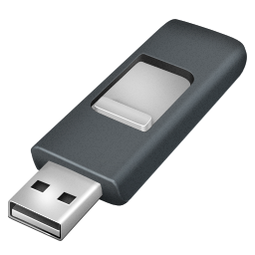


Attack vectors Evil maid

Slide 17



Attack vectors Evil border

Slide 18
Attack vectors Demo: Tampering with initrd
/
bin
conf
etc
init
lib
run
sbin
scripts
local-top
ash
echo
mitm
modules
...
drivers
init-top
local-bottom
cryptroot
cryptopen-sc
lvm2
stage1
grep

Slide 19
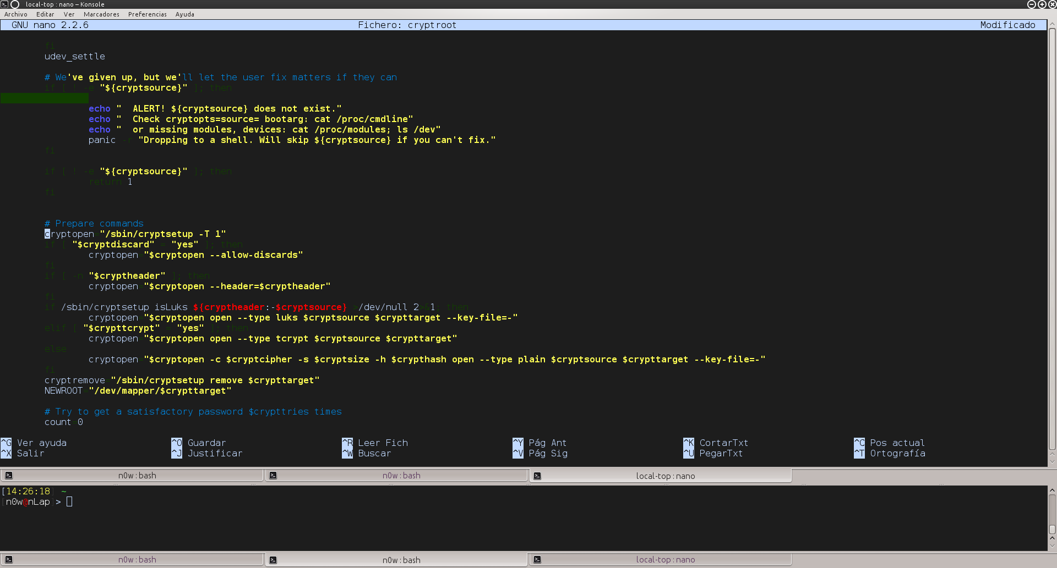
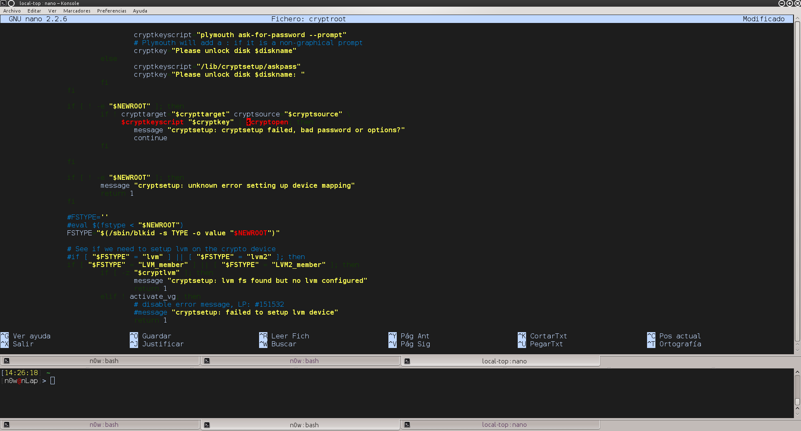
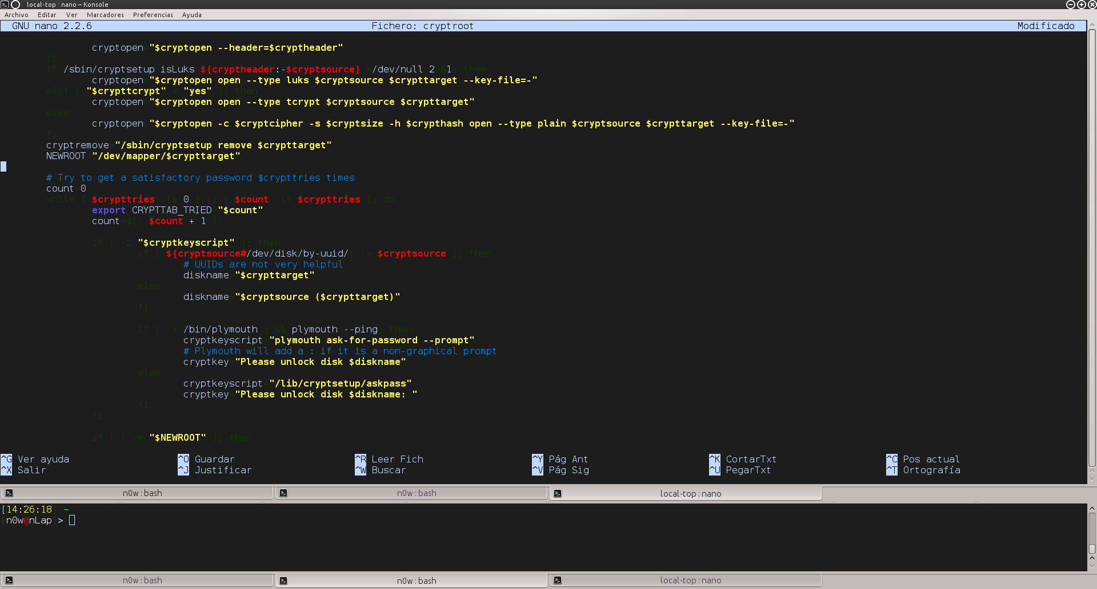
Attack vectors Demo: stage0
initramfs: /scripts/local-top/cryptroot

Slide 20
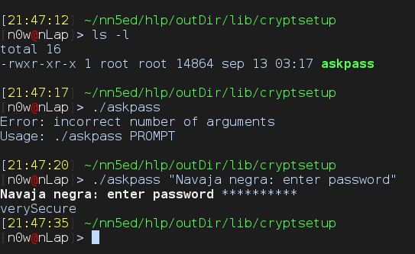
Attack vectors Demo: stage0
initramfs: /lib/cryptsetup

Slide 21
Attack vectors Demo: Tampering with initrd
stage0: Disk encryption password
Reads from stdin
Writes to stdout and file
stage1: Kernel module
Loads stage2
For demo purposes only
stage2: Profit!
Payload
Exfiltrates disk encryption password
Provides with reverse shell
r0 rootkit
keylogger

Slide 22

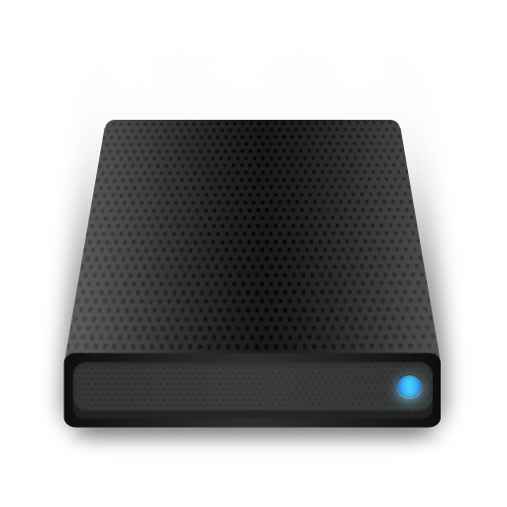
Demo! Tampering with initrd

Slide 23
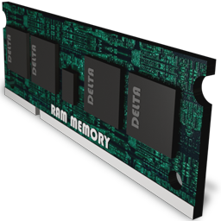
Bonus Demo! Key extraction from memory

Slide 24

Possible mitigations
External /boot partition
‘Real’ full-disk encryption
SecureBoot :D
encrypted luks container
/
/home
encrypted luks container
MBR
/boot
/
/home

Slide 25
References
0xAX: Linux Insides
Bart Trojanowski: Linux Kernel Walkthrough
Rebecca “.bx” Shapiro: A Toure of Bootloading
Wikipedia
Cryptsetup FAQ

Slide 26
Thanks for listening
Any questions?

